Slide 1
Clustering
Countries (Project #2)
K Means Clustering
& Agglomerative Clustering
DYLAN BERENS

Slide 2
Running country_data.info() shows there are a full 167 entries for all 10 columns, indicating there are no missing values
Missing Values?
Unique Values?
Running value_counts() on each column shows there are unique values ranging from 127 at minimum to 156 at most (excluding country)
Datatypes?
There are 10 Columns, 9 numeric and 1 is the country name (object)
Models?
The models used will be K Means Clustering and Agglomerative Clustering, a Dendogram will be generated as well as an elbow plot
Unsupervised Learning: Countries Dataset
The Country Data dataset used in this project lists 167 different countries, tracking things such as child mortality, exports and gdp. The goal is to cluster similar countries based on the included attributes

Slide 3
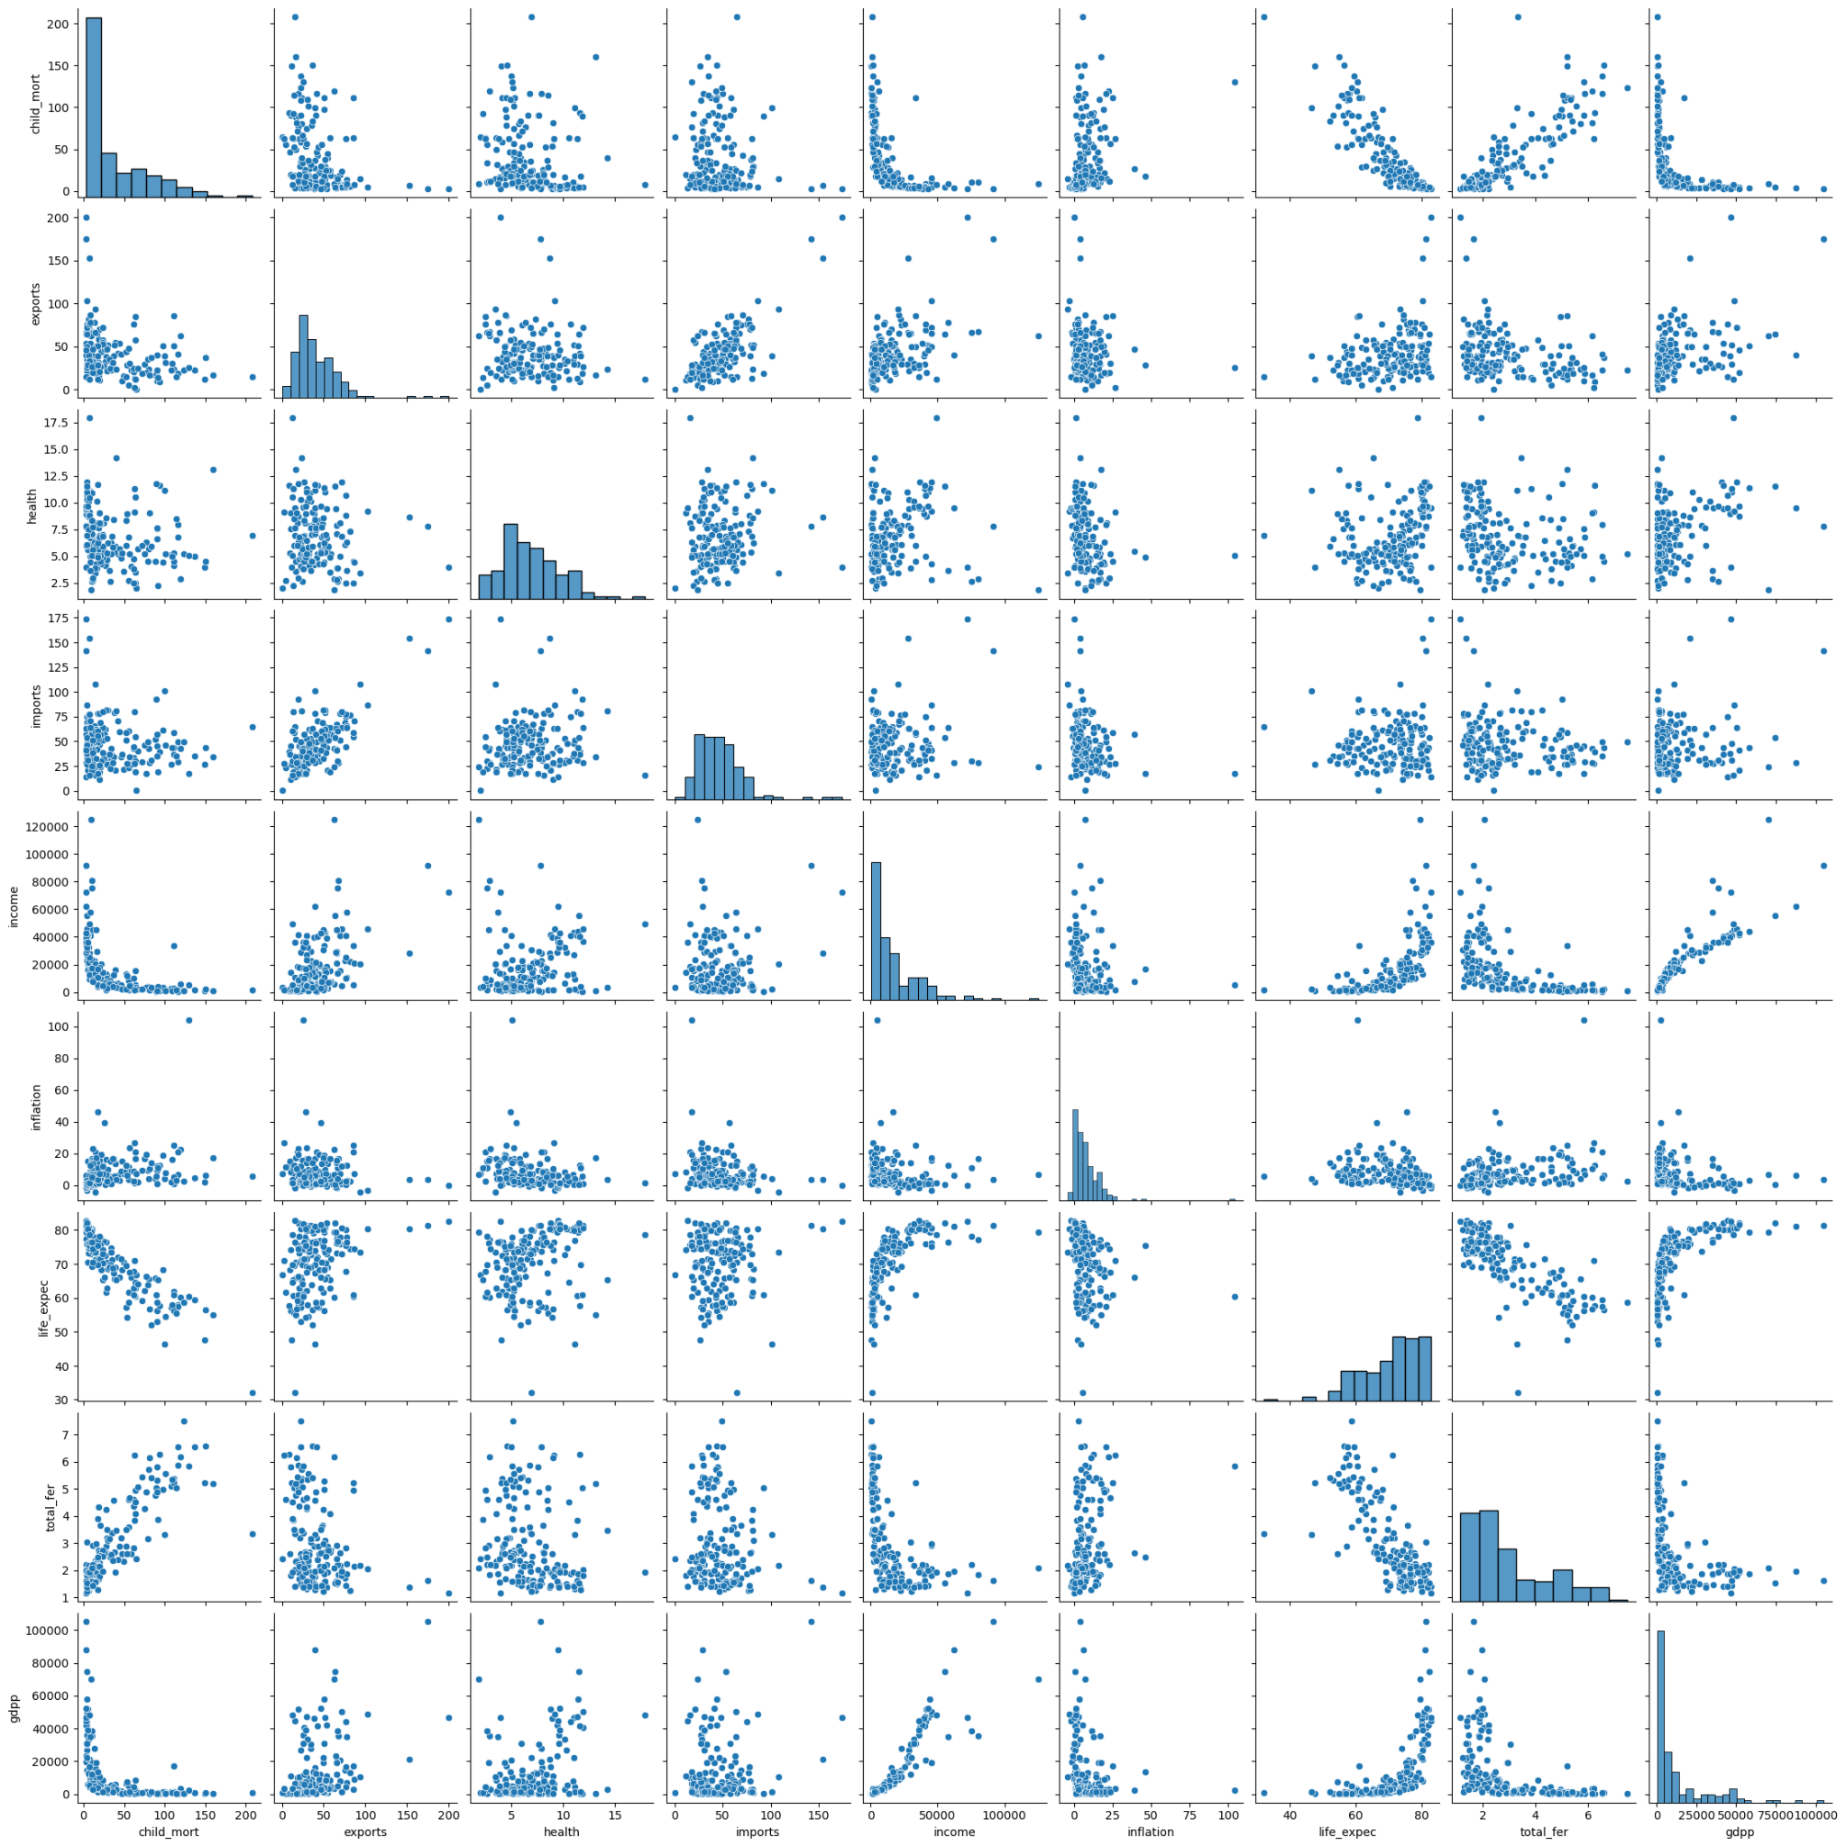
Data Exploration: Pairplot
The data exploration starts with a pairplot to help identify plots to explore in greater detail.

Slide 4
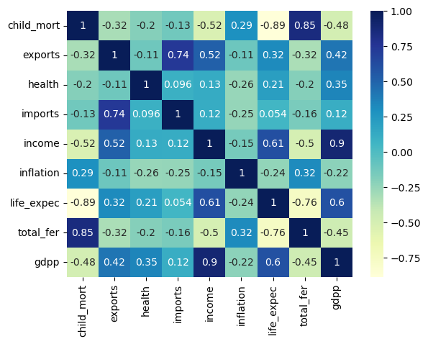
Data Exploration: Heatmap
The data exploration continues with a Heatmap, indicating plots that are worth exploring: child_mort vs. total_fert and life_expec, income vs. gdpp, and others with correlations well above 0.75

Slide 5
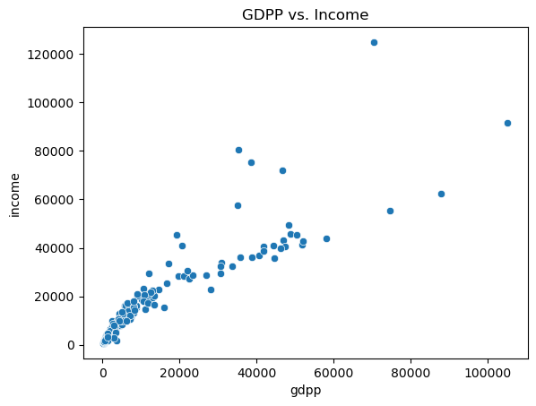
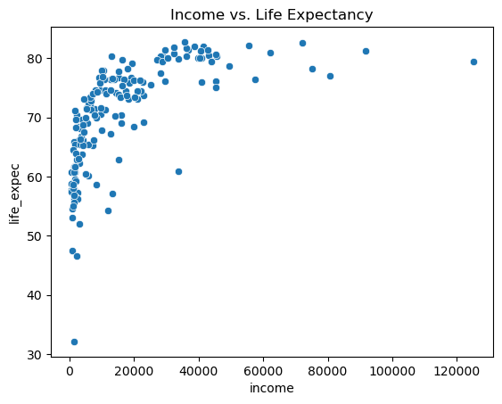
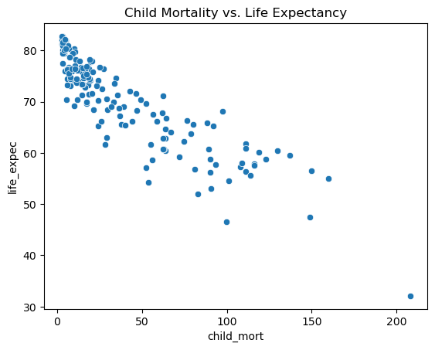
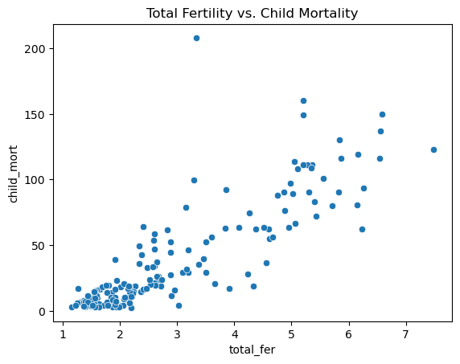
Data Exploration: Scatterplots
The scatterplots respectively show (clockwise): Higher life expec trends with higher income, fertility and child mort trend positively, child mort and life expec are negatively correlated, and GDPP and Income are positively correlated. These represent many of the strongest correlations in the heatmap

Slide 6
Scaling & PCA:
Scaling is necessary given the 9 numeric columns are not on the same scale (GDPP & Income are in the 10s of thousands while health and fertility are measured <100)
In order to plot the clustering on a 2 dimensional plane, this project employs Principal Component Analysis with 2 PCs

Slide 7
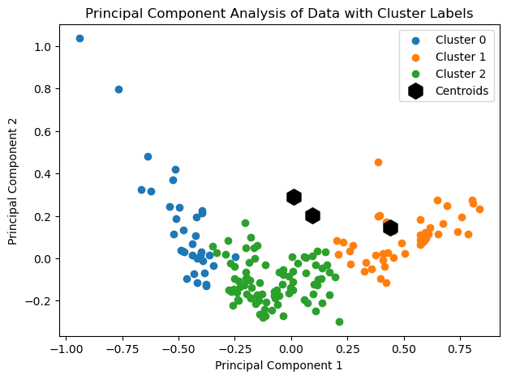
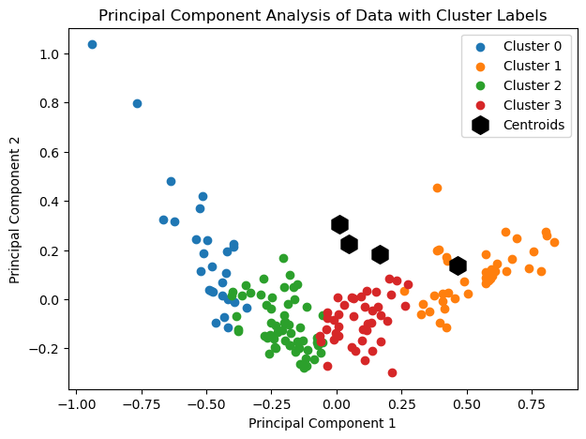
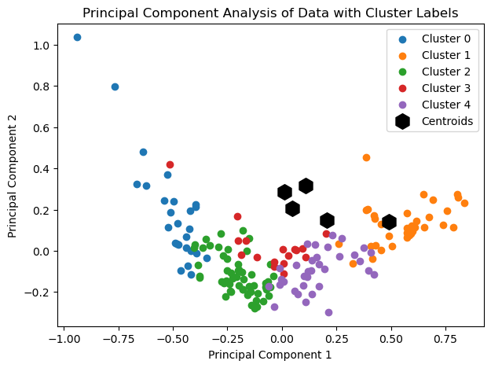





PCA with 3 Clusters
PCA with 4 Clusters
PCA with 5 Clusters
3 Cluster was the smallest amount of clusters that represented the data well
Silhouette Score: 0.805
4 Cluster was the strongest differentiation of clusters visually, as there was not unnecessary splits but unrelated groups were not conflated either
Silhouette Score: 0.825
5 Cluster was the highest amount that still retained relevant shape of the data. Additional clusters resulted in increasingly less logical subdivisions
Silhouette Score: 0.818
K Means Clustering
The strongest number of clusters was 4 from the above, based both on visual grouping and the Silhouette Scores. Higher k values resulted in some scores above 0.825, at the cost of groupings that did not make sense visually

Slide 8
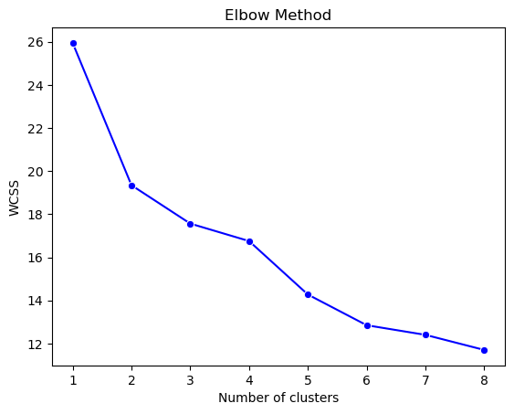
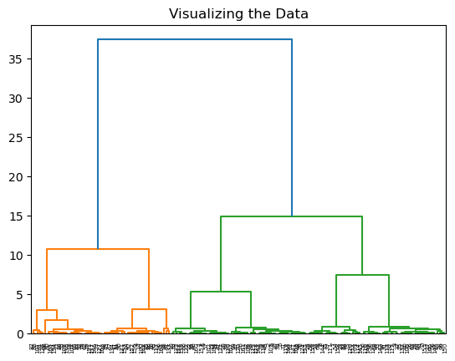
Supplemental Graphs
Elbow Plot (K Means)
Dendogram (Hierarchical)
The Elbow Plot for the K Means clustering model is slightly atypical given there is not a single elbow joint but multiple. In either case the strongest number for K appears to be 3, 5, or possibly 4
The Dendogram for Hierarchical clustering is the least preferred of the above ways of visualizing the data, as clear conclusions cannot be derived from a glance of this above plot

Slide 9
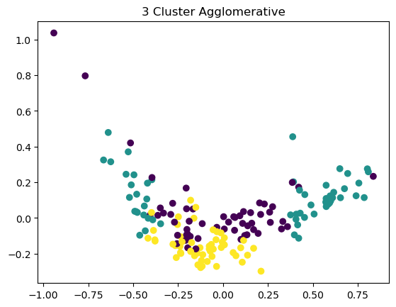
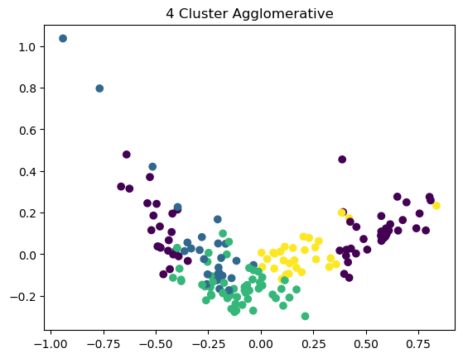
Agglomerative Clustering
Agglomerative clustering performed significantly worse than K Means clustering, indicated best visually in the following graphs
Agglomerative Clustering with 3 Clusters
Agglomerative Clustering with 5 Clusters
3 Cluster Agglomerative Clustering did not visually represent the countries in a strong way, with far more visual mixing that the K Means clustering.
4 Cluster Agglomerative Clustering performed even poorer, representing the countries visually in a way that is not clearly differentiated, with far more visual mixing that the K Means clustering.

Slide 10
Conclusion:
K Means Clustering was the stronger method for the dataset at visually representing the 167 countries through clustering
Of the 10 k values used, the strongest grouping was 4 clusters and 3 clusters
The models used are nonparametric
The PC1 was most important

